Slide 1
Learn to teach, for goodness sake. How RStudio certification is changing my teaching methods.
Mike K Smith, Pfizer R&D UK Ltd

Slide 2
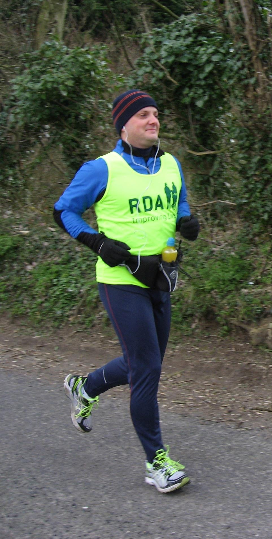
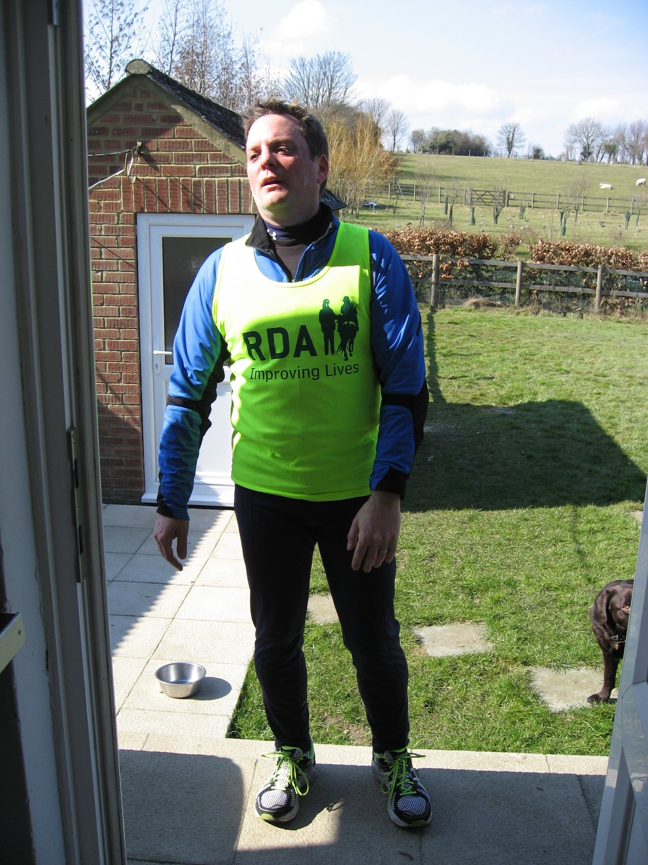
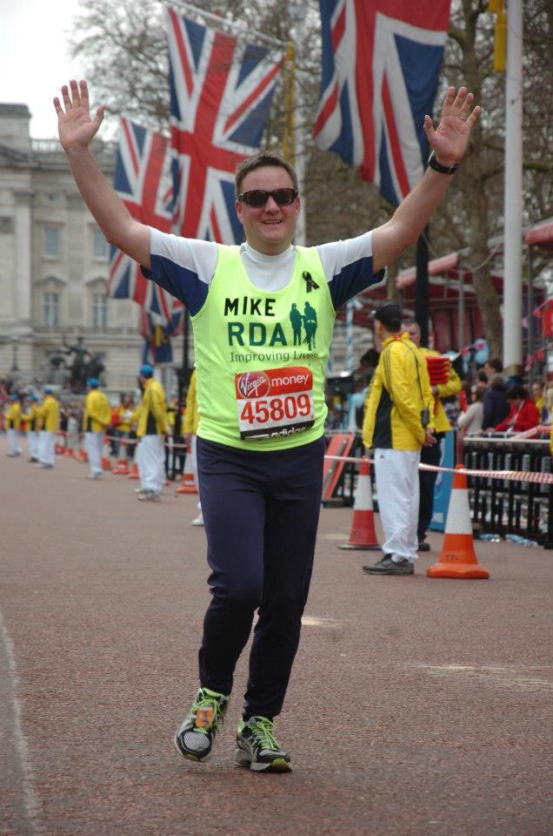
Learning R is a bit like running a marathon…
OMG, why is
it SO HARD??
(miles 8 - 26)
I can DO this!
(first 100 yards)
I DID IT!!
(last 100 yards)

Slide 3
…but you shouldn’t seek MY advice on how to train to run your best over 26.2 miles.

Slide 4
So why do we often turn to “experienced users” to train us in things like R?

Slide 5
There’s more to teaching R than “simply” telling others how YOU do R…

Slide 6
Certification training has changed how I approach training others…

Slide 7
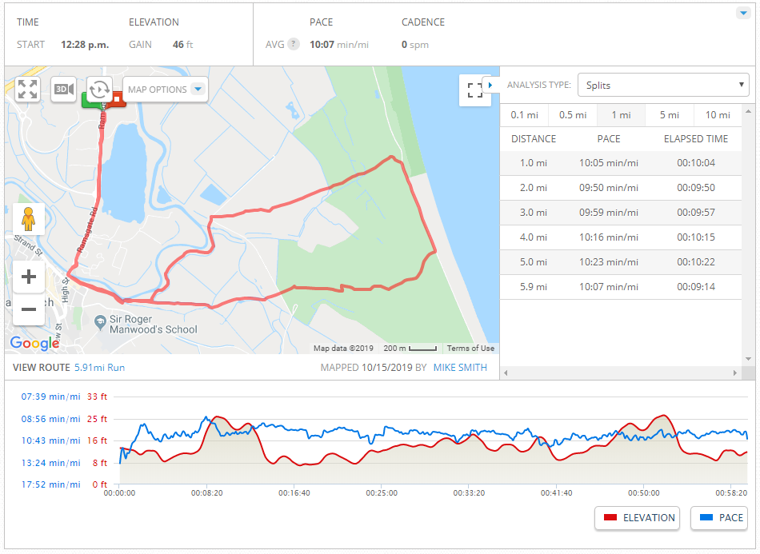
Providing concept maps helps learners associate concepts – help build training routes

Slide 8
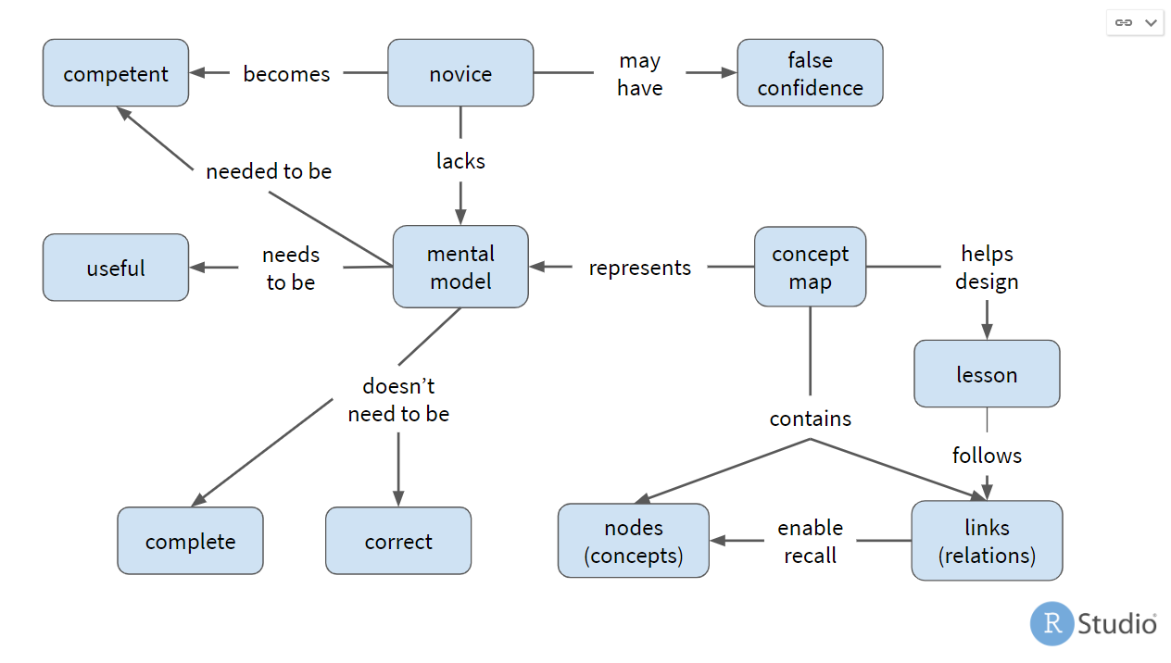
Providing concept maps helps learners associate concepts – help build training routes

Slide 9
Structure content to allow learners space to absorb the concepts …
Week 1 | 15 minutes jogging. | Rest | 20 minutes jogging. | Rest | Rest | 25 minutes jogging. | 1 hour ramble
Week 2 | 25 mins jogging | Rest | 35 mins jogging | Rest | Rest | 30 mins jogging | 75-min ramble
Week 3 | 30 mins jogging | Rest | 40 mins jogging | Rest | Rest | 35 mins jogging | 90-min ramble
Week 4 | 35 mins jogging | Rest | 45 mins jogging | Rest | Rest | 35 mins jogging | 1 hr jogging and walking.
Week 5 | 20-min run | Rest | 50 mins jogging | Rest | Rest | Timed run over a 2M course | 90-min ramble, or run in a 10K road race

Slide 10
… and use formative assessment to check progress.
Week 1 | 15 minutes jogging. | Rest | 20 minutes jogging. | Rest | Rest | 25 minutes jogging. | 1 hour ramble
Week 2 | 25 mins jogging | Rest | 35 mins jogging | Rest | Rest | 30 mins jogging | 75-min ramble
Week 3 | 30 mins jogging | Rest | 40 mins jogging | Rest | Rest | 35 mins jogging | 90-min ramble
Week 4 | 35 mins jogging | Rest | 45 mins jogging | Rest | Rest | 35 mins jogging | 1 hr jogging and walking.
Week 5 | 20-min run | Rest | 50 mins jogging | Rest | Rest | Timed run over a 2M course | 90-min ramble, or run in a 10K road race

Slide 11
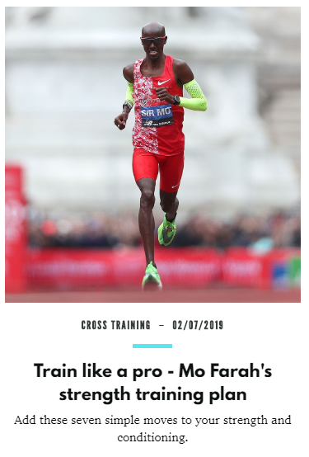

Each lesson should move at least one of the identified learner personas towards achieving their goal.

Slide 12

Each lesson should move at least one of the identified learner personas towards achieving their goal.
…Jacqui wants updates on what's new in RStudio products and related data science packages and tools, and advanced guides for making Shiny faster, integrated with no-SQL databases, and other high-value topics. She finds most self-paced tutorials frustrating because they're answering questions she doesn't have today.
Jacqui believes that time is money: every minute she spends learning something new has to pay off sooner rather than later.
Jacqui wants how-to guides and reference material for her day-to-day work, webinars to give her a sense of where the industry is going, and short, intensive online training for very specific topics.
- https://github.com/rstudio-education/learner-personas

Slide 13
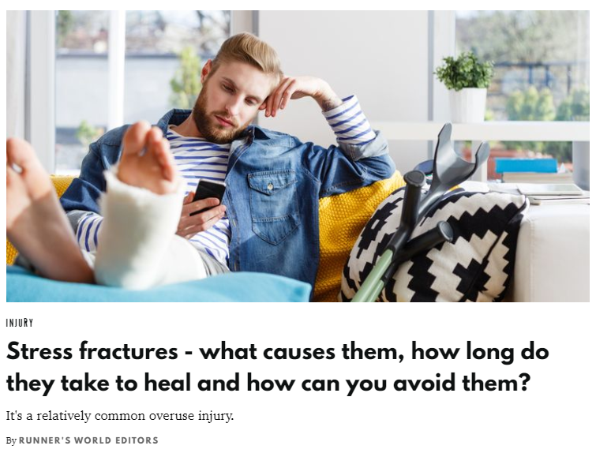
Doing too much too soon can lead to injury

Slide 14
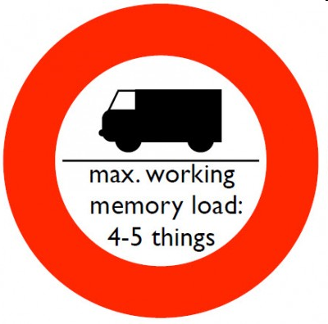
Doing too much too soon can lead to injury

Slide 15
The first time you run a mile is a BIG deal.

Slide 16
But by the time you can run for 6 miles, 3 miles is an “easy session”.

Slide 17
The journey - IDEAL
Achieve THEIR goals
As quickly as possible
I can DO this!
I DID IT!!

Slide 18


Find out more
Find a certified trainer near you:
https://education.rstudio.com/trainers#people
Become a certified trainer:
https://education.rstudio.com/trainers#info
Instructor training in February 2020. Contact Greg Wilson.
RStudio Education material (CC-BY-SA license)
https://github.com/rstudio-education
 @MikeKSmith
MikeKSmith
Mike.K.Smith@Pfizer.com

Slide 19
The backup pile

Slide 20
Certification – what’s the point?
Proficiency in teaching
Proficiency in technical skills
Certified trainers share best practice, keep up to date with latest developments and tools in tidyverse, Shiny.
Community of practice
Delegates being trained and organisations commissioning training by certified trainers can be confident that the training will be good.

Slide 21
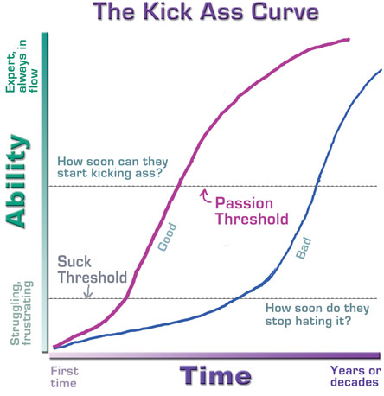
https://headrush.typepad.com/creating_passionate_users/2005/10/getting_users_p.html

Slide 22
http://www.slideshare.net/CJAtherton/chris-atherton-at-tcuk09
Notes:
People can really only retain about four bits of new, unrelated information — and sometimes not even that many. Don’t overstuff your presentation, and take care to signpost the key points — visually, verbally, however you want.

Slide 23
Evidence-based teaching methods
Learning paradigms
Concept maps &
Mental models
Learner personas
Formative assessments
Motivation
Feedback
Cognitive-load

Slide 24
Our job as trainers: Lead learners through the “suck” threshold, hopefully get them to the “kicking ass” threshold ASAP.

Slide 25
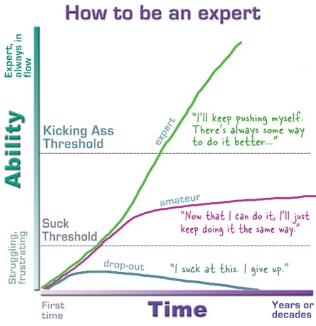
https://headrush.typepad.com/creating_passionate_users/2005/10/getting_users_p.html

Slide 26
Feedback
“Wow, for the first time I really UNDERSTAND what I’m doing with the ggplot mapping and aesthetics…”
“Very clear explanation. I think I can do this now…”
“Builds nicely…”, “Good flow…”
“Like the ‘paste into the right places’ exercise…”
“Liked the assessment exercise… makes people thing about code without having to necessarily generate it.”
“Didn’t really understand the concept map first time through…”
“Some of the text is a bit dense…”

Slide 27
Logistics
Lesson prepared locally
Using Github repo
RStudio Cloud instance using the Github repo
Learner invited to RStudio Cloud URL
https://rstudio.cloud/project/370395
Lesson presented as .Rmd file
Explanation interspersed with code chunks

